Slide 1
Ball Reversals and Paint Touches
Danny Henderson and Ayo Akinwole

Slide 2
Ball Reversals
Change Sides | Count | Success Rate | Points Per Possession
0 | 389 | 42.42% | 0.89
1 | 386 | 50.00% | 1.07
2 | 224 | 44.64% | 0.99
3 | 94 | 30.85% | 0.72
4 | 28 | 32.14% | 0.79
5 | 10 | 40.00% | 0.70
6 | 2 | 50.00% | 1.50
7 | 0 | N/A | N/A
8 | 1 | 0.00% | 0.00

Slide 3
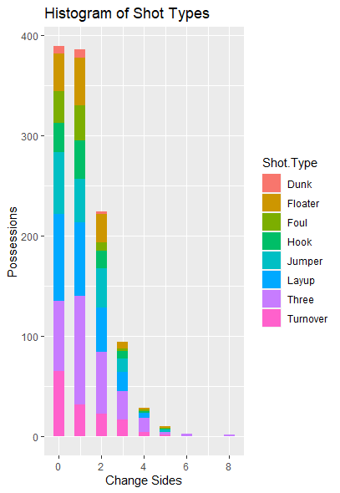
Ball Reversals
Distribution |  | Change Sides
Shot Type | 0 | 1 | 2 | 3 | 4
Layup | 22.37% | 18.91% | 19.64% | 20.21% | 17.86%
Floater | 9.77% | 12.44% | 12.95% | 7.45% | 7.14%
Hook | 7.71% | 9.84% | 8.04% | 8.51% | 7.14%
Jumper | 15.68% | 11.40% | 17.41% | 13.83% | 0.00%
Three | 17.99% | 28.24% | 27.68% | 30.85% | 50.00%
Dunk | 1.80% | 2.07% | 0.89% | 0.00% | 0.00%
Foul | 7.97% | 9.07% | 3.57% | 2.13% | 3.57%
Turnover | 16.71% | 8.03% | 9.82% | 17.02% | 14.29%

Slide 4
Paint Touches
Paint Touches | Count | Success Rate | Points Per Possession
0 | 509 | 34.38% | 0.90
1 | 811 | 51.05% | 1.05
2 | 217 | 54.38% | 1.07
3 | 24 | 50.00% | 1.08
4 | 6 | 50.00% | 1.00

Slide 5
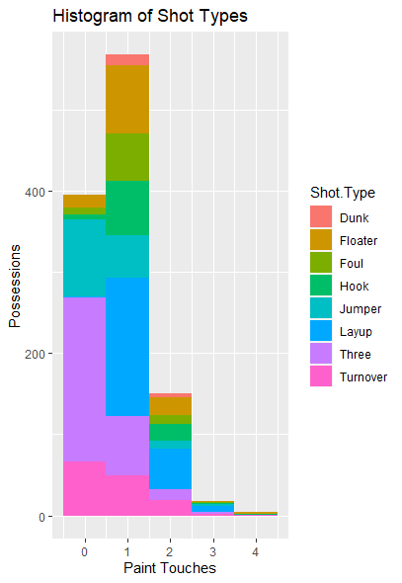
Paint Touches
Distribution |  | Paint Touches
Shot Type | 0 | 1 | 2 | 3 | 4
Layup | 0.00% | 29.72% | 31.34% | 37.50% | 16.67%
Floater | 3.34% | 15.91% | 17.97% | 20.83% | 50.00%
Hook | 1.38% | 9.74% | 11.98% | 4.17% | 16.67%
Jumper | 22.00% | 7.77% | 6.91% | 8.33% | 0.00%
Three | 55.21% | 15.04% | 11.52% | 16.67% | 0.00%
Dunk | 0.20% | 2.10% | 2.30% | 0.00% | 0.00%
Foul | 2.36% | 9.37% | 6.91% | 4.17% | 0.00%
Turnover | 15.52% | 10.23% | 10.60% | 8.33% | 16.67%

Slide 6
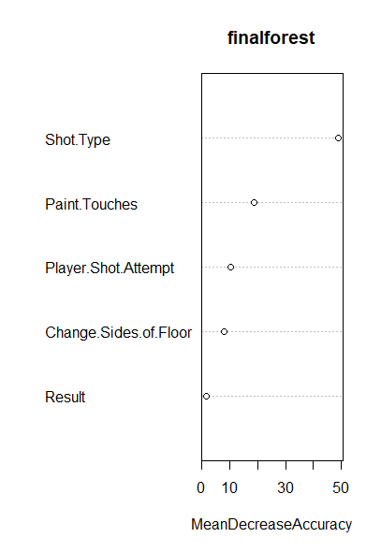
Random Forest
Ranks variable (most -> least significance)
Shot Type was statistically significant
Paint Touches had more than reversals

Slide 7
Conclusion
Ball Reversals were not significant
Paint Touches showed some significance
Get >0 Paint Touches

